Slide 1
SENTIMENT ANALYSIS
Group 13
M11015802 Eng Tze Qian
M11015080 湯傑堯
M11015018 陳彥家

Slide 2
Outline
Introduction
Data Pre-processing
Model
Experiment
Conclusion
2

Slide 3
Introduction
- Dataset and Explain
Sentiment Labelled Sentences Data Set / ACL Imdb
It is the best movie I ever seen.
It is so boring.
Dataset Split
Train : 80% Val : 10% Test : 10%
ACL IMDB / 50000
Amazon / 1000, IMDB / 1000, Yelp / 1000
3

Slide 4
Data Preprocessing
Standard pre-processing techniques
Lowercasing
Stopwords Removal
Stemming and Lemmatization
Words embeddings (TF-IDF)
Pre-processing Model
Tokenizer
Sequence Padding
Attention Mask
4

Slide 5
ULMFiT
Why Universal Language Model Fine-Tuning for Text Classification (ULMFiT)
Transfer Learning technique used in various NLP tasks
Has been state-of-the-art in NLP technique
Perform well even on small and medium datasets
5

Slide 6
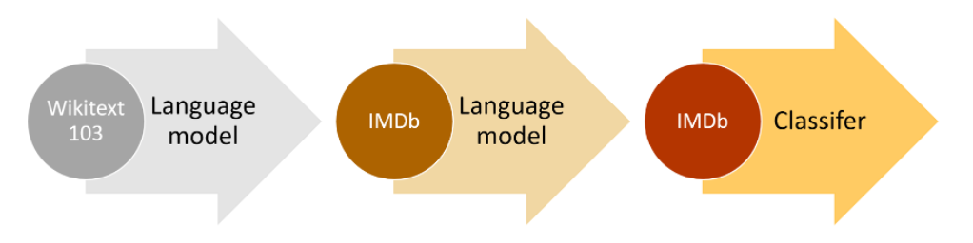
ULMFiT
Fine-tuning the pretrained language model
The language model is trained on wikitext-103
Wikipedia English is slightly different from the IMDb English
Whole model is freezed except the word embeddings
Fine-tuning the classifier
Discriminative learning rate
Gradual unfreezing
6

Slide 7
XLNet
Why we use this model ?
XLNet also incorporates the current optimal AR model
Transformer-XL.
Overcome the shortcomings of BERT with its characteristics of AR.
Let the language model decompose sentences from sequential to random.
7

Slide 8
XLNet
Clean Text
Training & Fine-Tune
Remove Punctuation, Numbers
EPOCH = 3 & LR = 3e-5
1
Pre Trained Model
0.75
Output & Predict
Load Model from Google
0.5
0.25
Tokenizer & Encode
0
'Hello'
[ 830 ]
EPOCH 1
EPOCH 2
EPOCH 3
Train Accuracy
Train Loss
8

Slide 9
Experiment
- Sentiment Labelled Analysis
Amazon
IMDb
Yelp
Combined
SVM
81.9%
74.5%
78.5%
81.5%
Naive Bayes
78.9%
78.1%
80.0%
82.2%
CNN
71.0%
81.0%
74.0%
75.0%
ULMFiT
77.8%
74.2%
76.8%
84.4%
XLNet
89.5%
95.5%
89.3%
92.7%
(Accuracy)
9

Slide 10
Experiment
- ACL IMDb
Train
Val
Test
SVM
98.0%
87.0%
89.0%
LSTM
98.9%
80.9%
85.0%
NN
99.9%
86.2%
85.0%
CNN
98.1%
83.2%
84.0%
BERT
97.7%
93.9%
93.8%
ULMFiT
94.3%
94.1%
91.6%
XLNet
96.3%
94.1%
93.9%
(Accuracy)
10

Slide 11
Conclusion
Transformer model (Bert, XLNet) is the current state-of-the-art approach
XLNet has Best accuracy , but High cost.
For training 3000 datas wtih batch size 4 need up to 10 GB.
Basic Neural Networks have serious over-fitting problem.
Epoch 1 has 61% accuracy and get 99% accuracy in Epoch 2.
A well training model for IMDb may not be good in other environments.
11

